Slide 1
Gaius Julius Caesar
Julius Caesar/The First Triumvirate/The End of the Roman Republic

Slide 2
Caesar’s Life
Julius Caesar was born in 100 BCE during very troubled political times in Rome.
Two leading political figures are at the center of Rome’s chaos: Marius (157-86) and Sulla (138-79).
Marius served for consul 7 times, was known for opposing conservative factions, and was married to Julius Caesar’s aunt. He was a member of the populares faction.
Sulla was Marius’s general and a Roman dictator while Caesar was in his teens. Sulla favored Rome’s conservatives (optimates). After marching on Rome and taking it twice, he made motions to restore power to Rome’s senate.

Slide 3
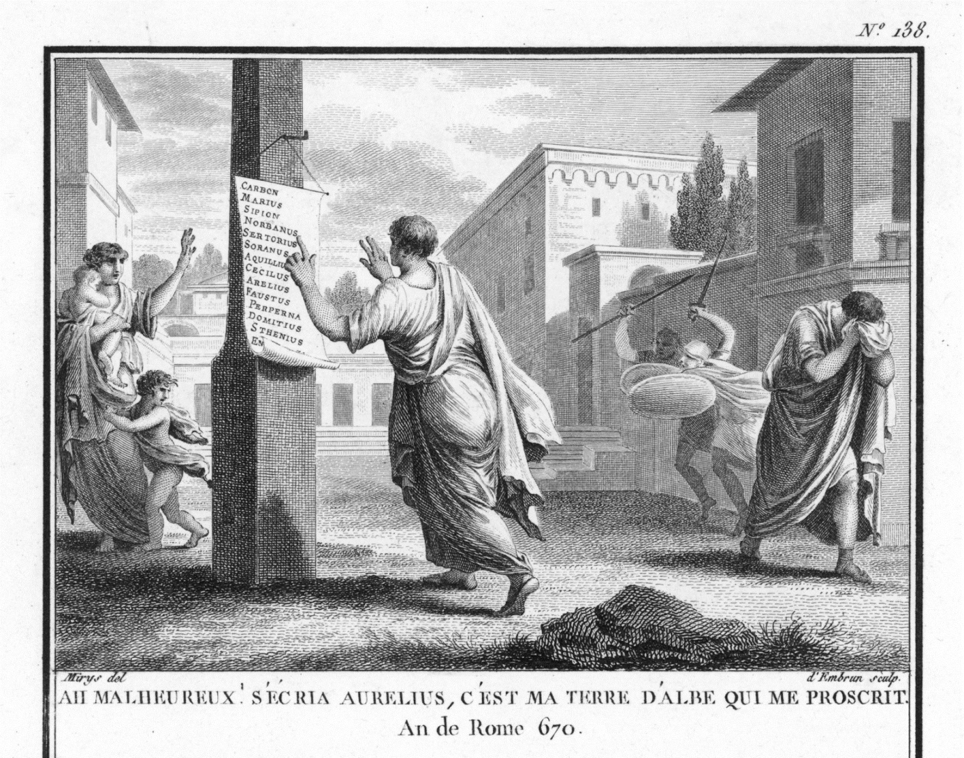
Caesar’s Life
Sulla was the first Roman general to take on a “proscription”.
Pompey benefited greatly from Sulla’s proscription during his teenage years and was given the nickname adulescentulus carnifex, teenage butcher.
Caesar, because of his familial association with Marius and his refusal to divorce his wife whose family had been hostile to Sulla, had to travel East until things became safer in Rome.

Slide 4
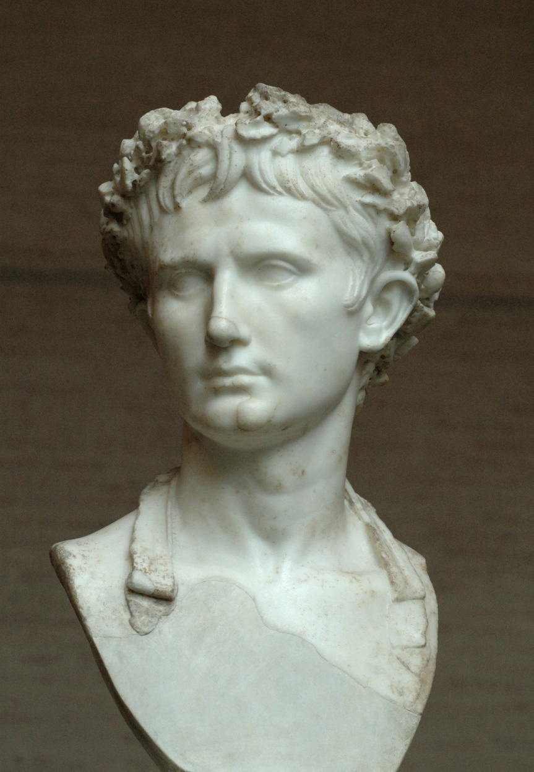
Caesar’s Life
While out East, Caesar served as a Roman official (as did many upper-class youths) and participated in battle.
He earned the corona civica or the “civic crown” which is bestowed upon those who saved a fellow citizen in battle.
He was also captured by pirates. After his ransom was paid, he hunted down the pirates and had them crucified which he personally oversaw (ironic that he warned the pirates that this would happen).
Augustus wearing the corona civica

Slide 5
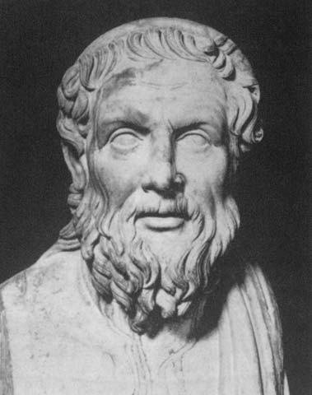
Caesar’s Life
While in the East, Caesar also studied under a Greek tutor , Apollonius, who happened to have taught Cicero rhetoric. Caesar was known as the second best public speaker of his time.
Caesar’s early career contained many official posts, both military and civil. His elected posts included an aedileship in 65 BCE and his scandalous service as the pontifex maximus in 63 BCE (scandalous because he was too young and borrowed huge sums of money for bribery. In fact, when Caesar tried to leave for Spain in 61 to govern the province, his creditors tried to block him. Crassus had to bail him out).
Apollonius

Slide 6
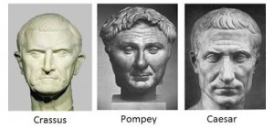
Caesar’s Life
When Caesar paid off his debts from becoming wealthy in Spain, he prepared to run for the consulship.
Caesar was backed by both Pompey and Crassus who hated each other. Caesar united the two in amicitia and created the first triumvirate.
Pompey married Caesar’s daughter Julia to solidify a stronger bond between the two men.
When Caesar was elected consul in 59 BCE, he used dubious methods such as physically stopping his colleague Bibulus from participating in motions so that he could not veto any motions which would stop legislation from being passed which was designed to benefit Caesar’s “friends” (i.e. Pompey and Crassus).

Slide 7
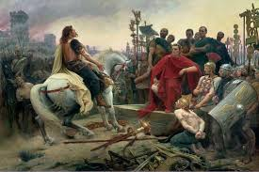
Caesar’s life
After his consulship, Caesar received a proconsulship in transalpine and cisalpine Gaul for a period of 5 years. When he became involved in conquering the rest of Gaul (mostly France), Caesar realized that it would take more than 5 years.
Caesar was able to renew his alliance with Pompey in Crassus in 56 and to complete the conquest of Gaul by 50. While in Gaul, Caesar made himself and the Roman state immensely wealthy which made him popular with the people. He also increased the size of his army through this wealth.
Vercingetorix surrenders to Caesar

Slide 8

Caesar’s Life
In Rome, the political arena found itself at a critical point. Caesar’s daughter Julia, who was married to Pompey, died in childbirth in 54 BCE.
Crassus was defeated by the Parthians in 53 BCE and died in battle.
With Crassus’s death, Pompey began drifting into a closer alliance with leaders in the senate.
Eventually, the senate convinced Pompey to recall Caesar from Gaul. Caesar refused to obey. The senate enacted Julius Caesar as an enemy to the state.
Cato the Younger from HBO’s Rome

Slide 9
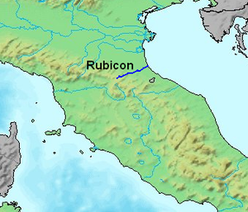
Caesar’s Life
After hearing the Senate’s request to disarm, Caesar delayed for a day before he crossed the Rubicon River in January 10th, 49 BCE. He uttered the famous phrase, “alia iacta est”.
Having been taken by surprise, Pompey and the Senate fled to Greece. Caesar secured Italy and then met Pompey in battle at Pharsalus, Greece in 48 BCE. Caesar won and Pompey fled to Egypt where he was assassinated by King Ptolemy VIII. Caesar landed in Egypt too late to meet Pompey in battle again, but became in a foreign dispute over who had the right to rule in Egypt: Ptolemy or his sister/wife Cleopatra.

Slide 10
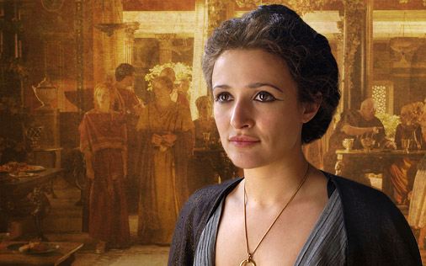
Caesar’s Life
Caesar supported Cleopatra over her brother. After settling affairs in Egypt (and supposedly fathering a child with Cleopatra), he moved on to the East in 47 BCE.
But the civil war was not over. Caesar had to fight senatorial armies in North Africa (46 BCE) and then in Spain (45 BCE).
After the civil wars had ended Caesar was faced with having to reestablish constitutional government. The senate gave Caesar the title “dictator for life” in 44 BCE. Caesar argued that he invaded Italy to defend the tribunes who supported him and the interest of his soldier’s and honors.
Cleopatra from HBO’s Rome

Slide 11
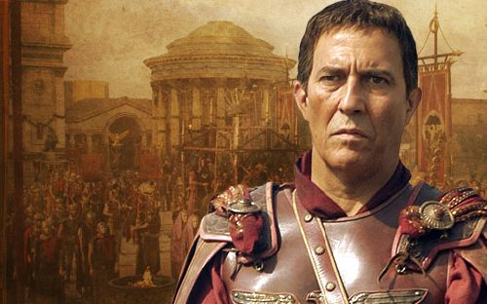
Caesar’s Life
There is some evidence that Caesar wished to become a king. However, this remains far from settled.
During his short lived administration, he tried to settle economic affairs by relieving debt. This satisfied neither creditors or debtors.
He also reformed the calendar. Logic dictated that the new year should being on the day after the winter solstice, but Roman religion required delay. We still live with that delay today and with the additional month named after the dictator: July.
Julius Caesar from HBO’s Rome

Slide 12
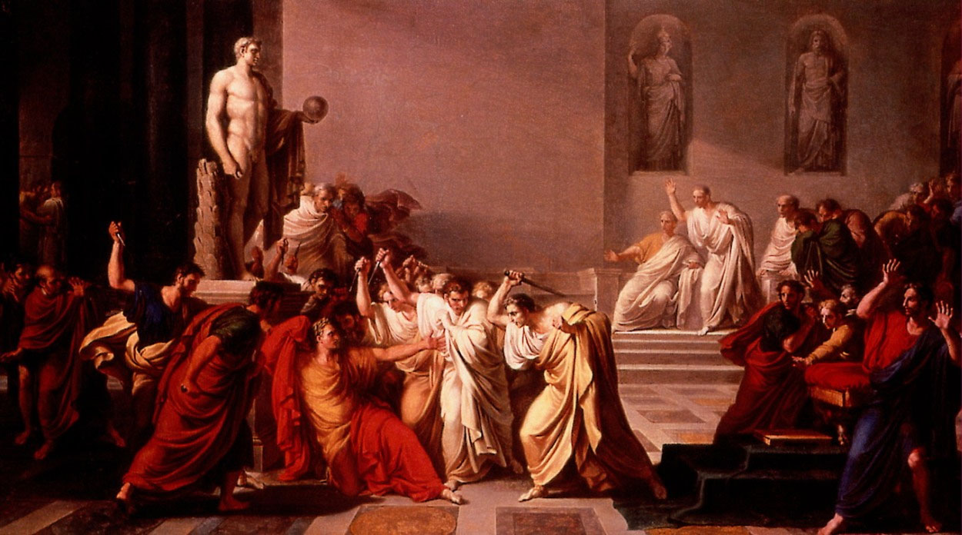
Caesar’s Life
The major political policy that brought Caesar’s early demise was clemency (forgiveness). He believed that people who owed their lives to him would demonstrate future gratitude. He was wrong.
Many of those whom Caesar forgave were conspirators of his assassination. The conspirators struck during a meeting of the Senate at the Theatre of Pompey on March 15, 44 BCE, the eve of Caesar’s planned departure for Parthia where he hoped to avenge Crassus’s humiliating defeat.
Assassination of Caesar at the base of the statue of Pompey

Slide 13
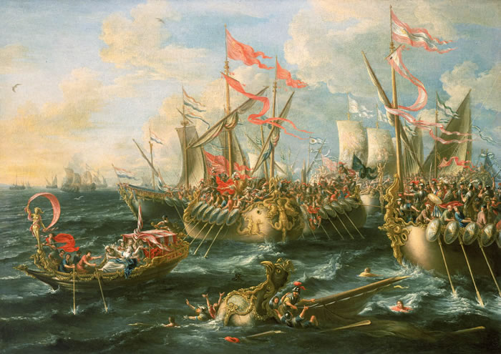
Caesar’s Legacy
At his death, Caesar was declared a god by the Senate and another round of civil wars erupted.
In his will, Caesar had adopted his great nephew, Gaius Octavian, who had adopted Caesar’s name.
Long story short, a Second Triumvirate was created between Octavian, Marc Antony (Caesar’s leading general in Gaul), and Marcus Lepidus. Lepidus quickly falls out of the scene leaving conflict between Octavian and Antony. Octavian and his general, Marcus Agrippa, beat the forces of Antony and Cleopatra, at a naval battle in Actium, Greece. Octavian is victorious and becomes Rome’s 1st emperor in 31 BCE.
Battle of Actium

